Slide 1
TurboSched
Core Computation and Other Challenges
- Parth Shah <parth@linux.ibm.com>

Slide 2
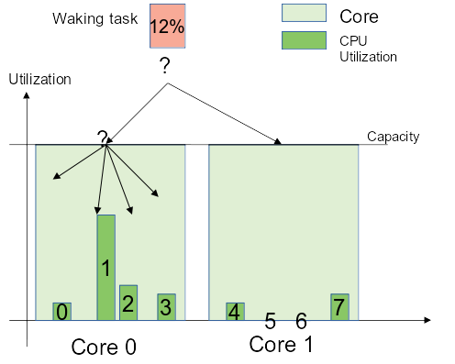
Overview of Challenges
Is the Task Jitter ?
Any "Core Capacity" left? - to pack jitter task on the busy core
Non Idle core Search Span

Slide 3
Core Capacity Computation
Jitter Classification Interface
Syscall
Cgroup
Objective:
Select non idle/busy core
Find if the enough capacity is left for packing jitters on the core
Determine if the core gets overloaded after jitter packing
Current Approach:
Use CPU capacity to calculate Core capacity such that
Core capacity = K * cpu_capacity(first_cpu) where K is linear factor with K=1.5 for SMT- 4 and K=2 for SMT-8 core
Search Domain for Non Idle Core
DIE
Exhaustive but efficient for sustaining Turbo
LLC
Generic across architecture but gets less benefit of task packing

Slide 4
This work represents the view of the authors and does not necessarily represent the view of the employers (IBM Corporation).
IBM and IBM (Logo) are trademarks or registered trademarks of International Business Machines in United States and/or other countries.
Linux is a registered trademark of Linus Torvalds.
Other company, product and service names may be trademarks or service marks of others.
Legal Statement

